Slide 1


The Wonders of Face Identification
IT3320E INTRODUCTION TO DEEP LEARNING
Doan Ngoc Cuong 20210141​
Nguyen Minh Cuong 20210140​
Bui Khanh Linh 20214910​
Tran Le My Linh 20210535​
Nguyen Thanh Long 20214912
Nguyen Minh Tuan 20214940
1
Notes:
Good afternoon professor and everyone. My name’s Linh and today I will present you about our project: Face identification

Slide 2
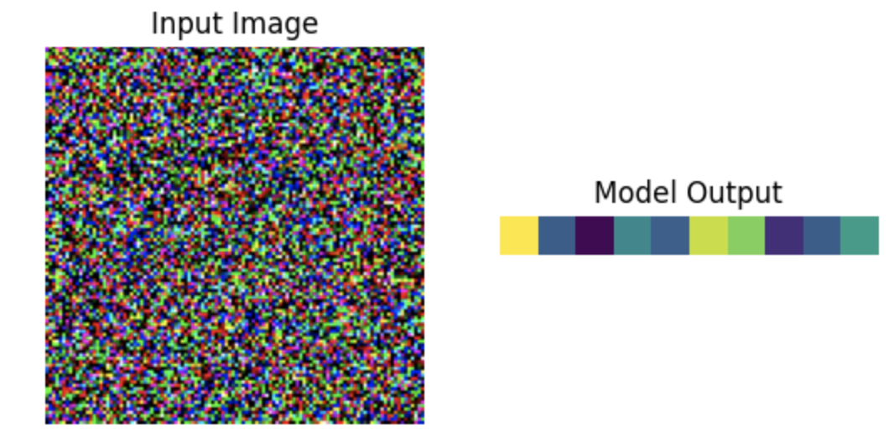
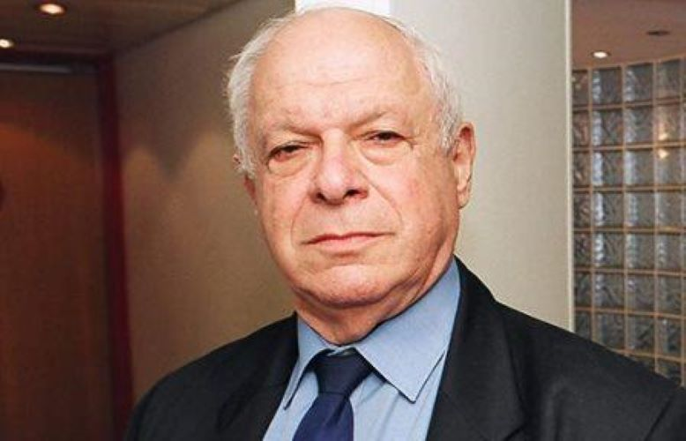
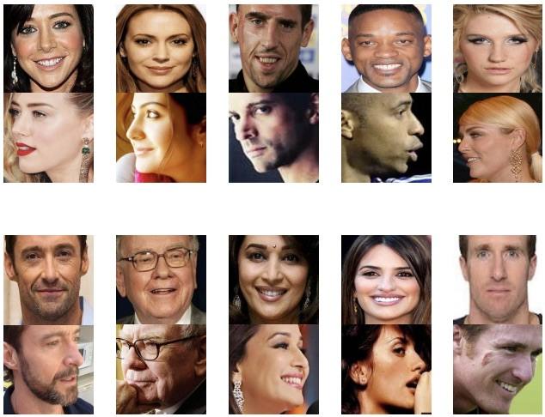
Face Recognition Workflow
Input frame
Face detection
Face verification
Feature extraction
Compare distance between 2 imgs encoding
Feature extraction
The same person
No
Face database/gallery
2
Notes:
Our project solves the task of distinguishing whether two photos belong to the same person or not.
Our input is a portrait photo.
After undergoing face detection, the photo proceeds to task 2, where we extract facial features, resulting in a vector containing these characteristics.
To compare with other images, we maintain a gallery with extracted features from various faces.
Once we have the characteristics of two photos, we compare the distance between them to determine the answer

Slide 3
Outline
Dataset
Model
- Overview
- Augmentation
- Face Detection
- Face Alignment
- Feature Extraction
Result
Conclusion
Comparison and result
Findings, conclusion and improvement in future
3
Notes:
●In this presentation, I am first going to introduce the data and its preparation.
●Secondly, I would like to go through Methodology, algorithms, and framework details.
●Next, I will talk about results and finally it’s conclusion

Slide 4
Dataset
4
Notes:
Let’s begin with the first part, data

Slide 5
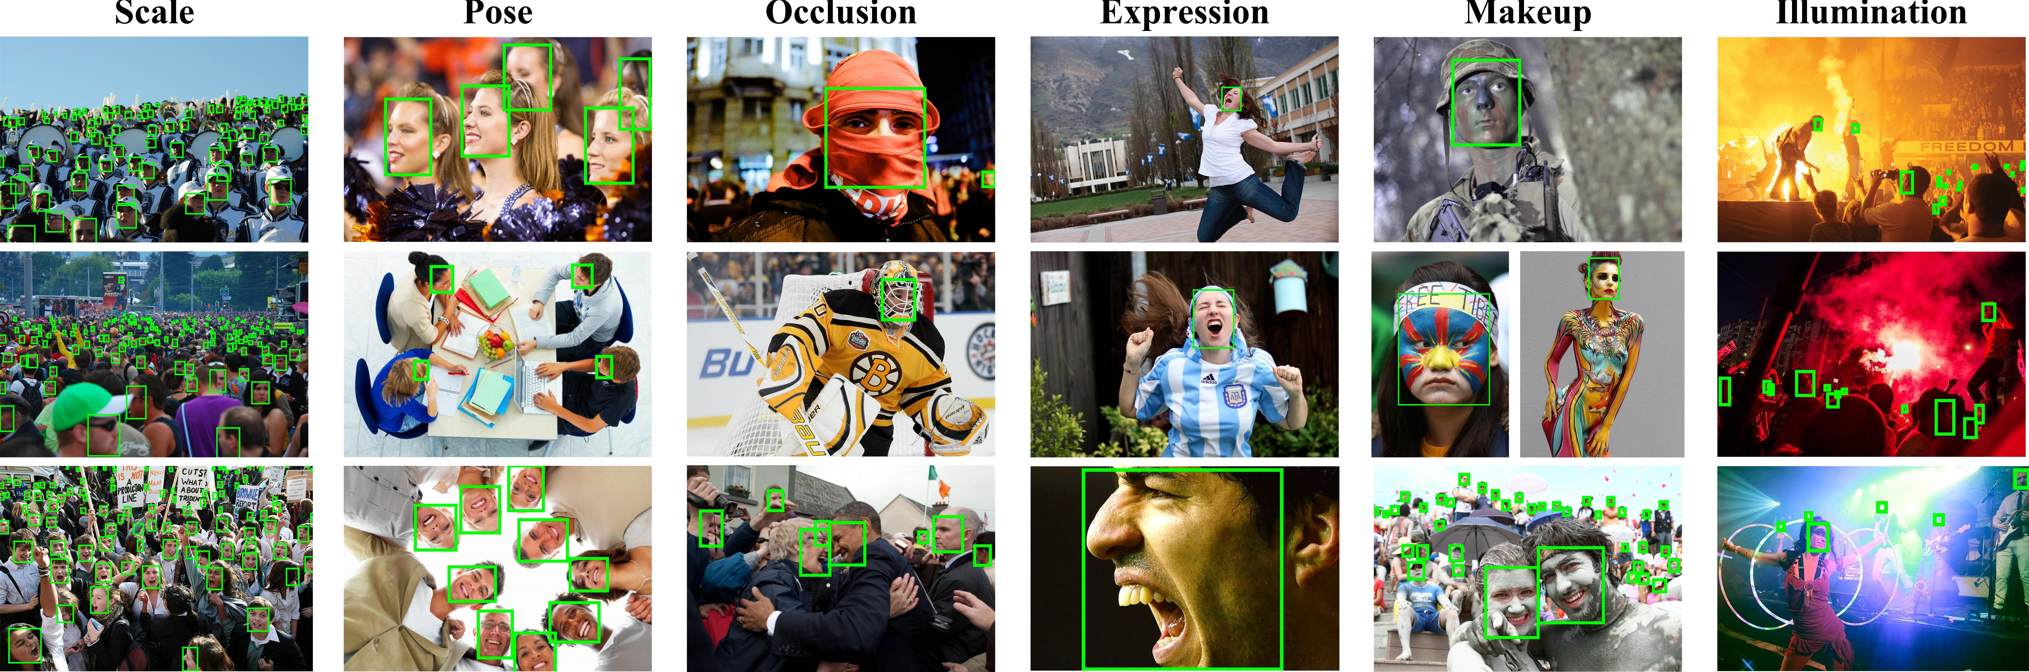
Face Detection
Total images
32 203
Number of faces
393 703
Image dimension
Variable
Source
WIDER FACE
WIDER FACE
5
Notes:
This is the overview of dataset for face detection task.
WIDER FACE dataset is a face detection benchmark dataset, which contain about thirty thousand images and label four hundred thoundsand faces with a high degree of variability in scale, pose and occlusion

Slide 6

Face Detection
Resizing
Resize to 300x300 for SSD
Resize to 640*640 for Yolov5
Resize to 12x12 for PNET, 24x24 for ANET, 48X48 for ONET (MTCNN)
Others
Normalize, Random Crop for SSD
6
Notes:
We applied various data preprocessing and augmentation techniques to enhance the diversity of our dataset and to fit to the input of model.
This involved resizing, normalization, and augmentation methods to ensure improved model training and robustness

Slide 7
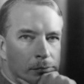
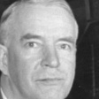








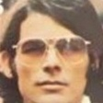

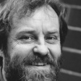

Feature Extraction
Total images
5,180,000
Number of people
More than 90 000
Image dimension
112x112
Source
Ms1m-retinaface
7
Notes:
For training feature extraction task, we use the MS1M RetinaFace dataset.
This dataset is known for its extensive collection of high-resolution facial images, which facilitated our training process for accurate facial recognition

Slide 8
Feature Extraction
Resizing
Resize to 112 x 112 for InceptionV2
Resize to 256x256 for VGG16
Resize to 224x224 for ArcFace
Others
Horizontally flip, Rotate for InceptionV2, ArcFace
Normalize for ArcFace
8
Notes:
This is the augmentation we applied for the second task

Slide 9
Face Detection
SSD - YOLOv5 - MTCNN
9
Notes:
Let’s continue with the techniques we used in this project
For the first task, face detection, we use Single Shot Multibox Detector, You only look once v5 and Multitask convolution neuron network

Slide 10
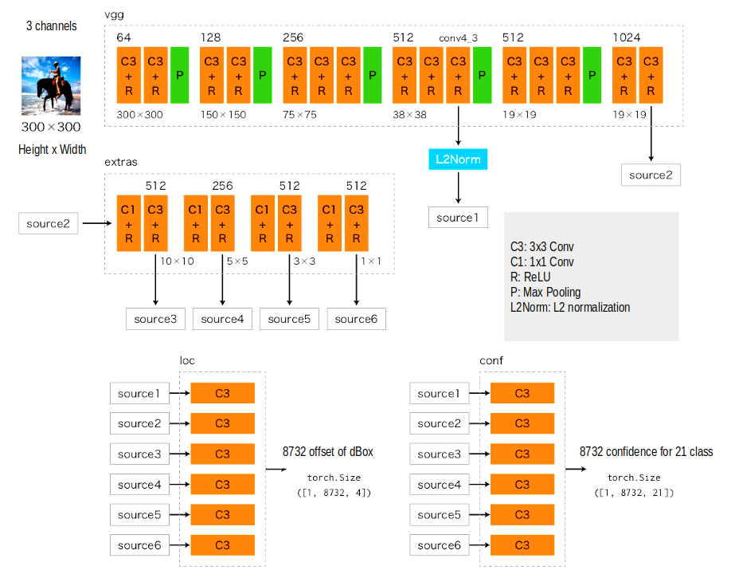

Face Detection
SSD
Objective loss:
L(x,c,l,g) = (Lconf(x, c) + αLloc(x,l,g)) / N
- Lconf is CrossEntropy Loss
- Lloc is SmoothL1 Loss
Input resolution: 300x300
Output vector size: 5
10
Notes:
SSD generates a fixed-size array of 8732 multiple shape bounding boxes and scores for object class instances within those boxes. And choose top 200 boxes with highest scores.
There are 4 main modules: VGG, Extras, Loc and conf

Slide 11
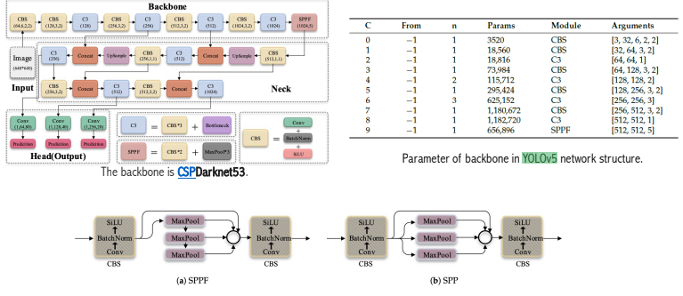
Face Detection
Yolov5
Model Architecture: YOLOv5 uses:
Backbone: CSPDarknet53 backbone (a modification of the Darknet configuration that was used in previous versions).
Neck: SPPF and CSP-PAN is used for the Neck part.
Head: Output of YOLOv3.
11
Notes:
Yolov5 and Yolov5s: In this section, we focus on deploying the YOLOv5s model, specifically tuned for the task of face detection. YOLO (You Only Look Once) is a state-of-the-art, real-time object detection system, and YOLOv8 is the latest in this series. The ’s’ in YOLOv5s stands for ’small’, indicating that this model is the smallest and fastest variant, making it ideal for applications that require real-time processing with limited computational resources.

Slide 12
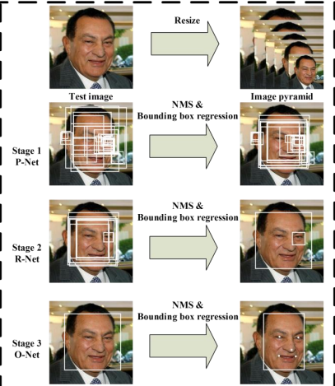
Face Detection
MTCNN
Pipeline of MTCNN model that includes three-stage multi-task deep convolutional networks
12

Slide 13
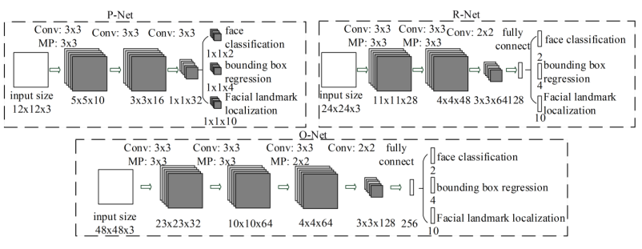
Face Detection
MTCNN
The architectures of P-Net, R-Net, and O-Net, where “MP” means max pooling and “Conv” means convolution. The step size in convolution and pooling
is 1 and 2, respectively
13

Slide 14
Face Alignment
ADNet - MTCNN
14
Notes:
For face alignment task, we use ADNet and MTCNN.

Slide 15
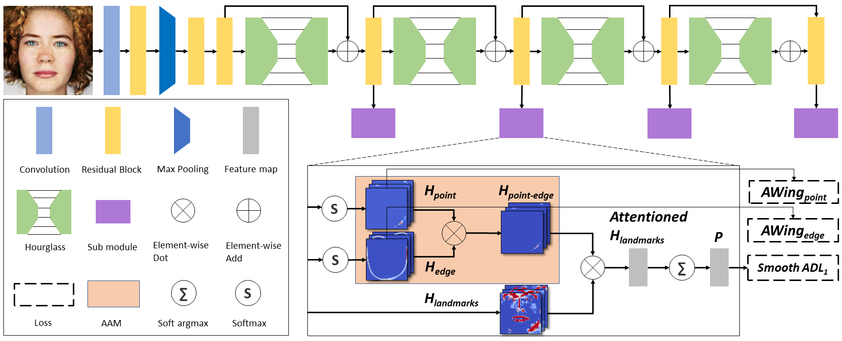
Face Alignment
ADNet
ADNet with ADL and AAM .
Anisotropic Direction Loss (ADL) applies strong constraint in the normal direction of the facial boundaries.
Anisotropic Attention Module (AAM) focuses on local point and edge regions providing loose constraint in the tangential direction for coordinate and heatmap regression.
15
Notes:
ADNet Research: In our research on face alignment, we research the ADNet network developed by researcher... from Microsoft Research Asia. This network solves the problem of skew in the error distribution of facial feature points.

Slide 16
Feature Extraction
MobileNet+ArcFace-Inceptionv2-VGG16
16

Slide 17
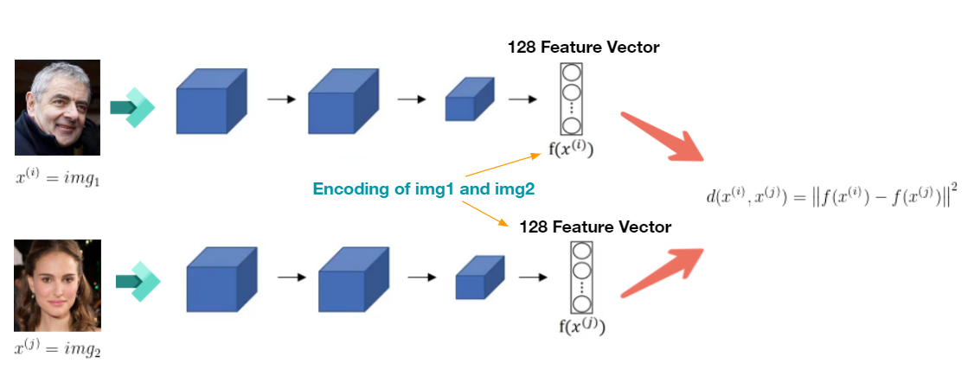
Feature Extraction
17
Notes:
As mentioned, we need to extract facial features, so our model will use an image as input, train it on the model and create an embedding vector. If we want to compare two images, we only need those embedding vectors to compare the distance between them

Slide 18
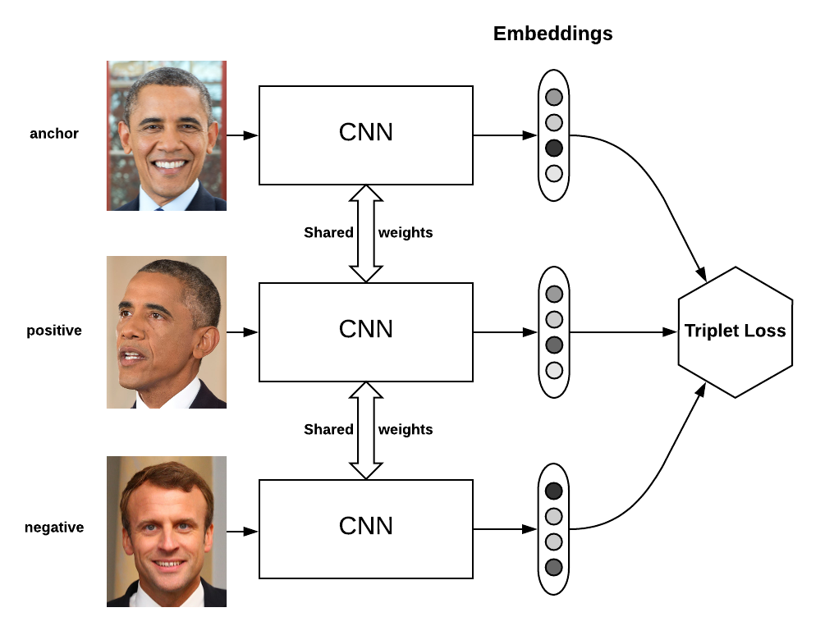
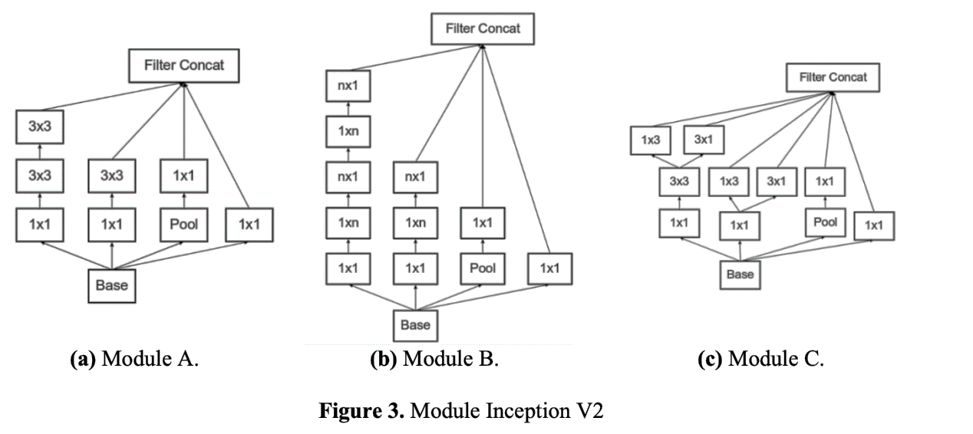
Feature Extraction
Inceptionv2
The project achieved an accuracy of 88%, which is within the acceptable range for facial recognition.
Input resolusion: 112x112
Output vector size: 128
18
Notes:
=- Inception V2 was a module that designed to reduce the complexity of convolution network. This module makes convolution network going to be wider than deeper. Inception V2 has three different type modules said A, B, C. They are showed by figure 3
- The fist module (A), showed by Figure 3.a. This module replaces the 5x5 convolutions with 3x3 convolutions. (improvement purposes: A 3x3 convolutional filter has fewer parameters than a 5x5 filter. The number of parameters in a convolutional layer is proportional to the square of the filter size. Therefore, a smaller filter reduces the number of learnable parameters, making the model more parameter-efficient. The computational cost of performing convolutions with 3x3 filters is generally lower than that of larger filters. )
>>>>>>Overall, the use of 3x3 convolutions provides a good balance between capturing complex patterns, reducing the number of parameters, and maintaining computational efficiency, contributing to improved performance in convolutional neural networks.<<<<<
- By factorized convolutions filter size n x n into 1 x n and n x 1 convolutions, found their method 33% cheaper than the single 3x3 convolution. This was showed by Figure 3.b as module B.
Moreover, the filter was expanded that followed the principle of higher dimensional representations are easier to process locally within a network. The expanded module was showed by figure 3.c.
=- In summary, Inception V2's modules A, B, and C aim to simplify convolutional networks by utilizing more efficient convolutional operations, such as replacing 5x5 convolutions with 3x3 convolutions and employing factorized convolutions.
=- Our input size is 112x112, after passing inception v2 model we have an output of 1 embedding vector of 128 dimensions, we use triplet loss for this model so that they can identify 2 similar people as anchor and positive, and the different person is negative

Slide 19
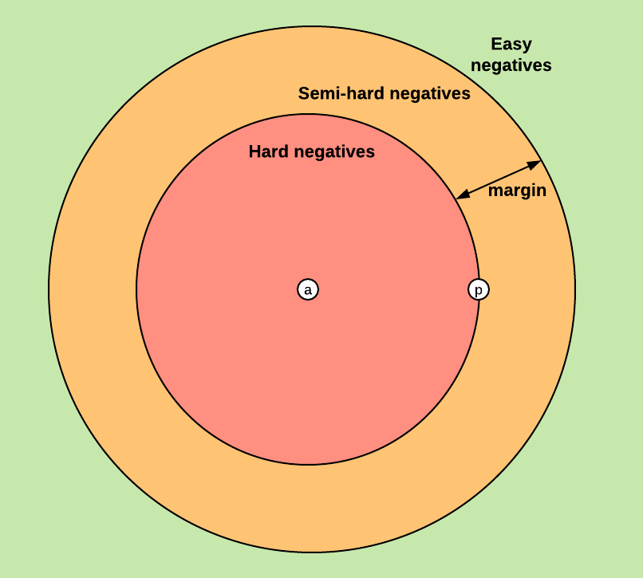
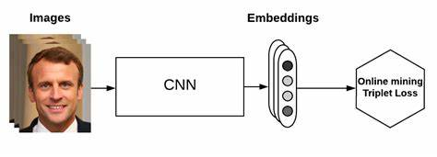
Feature Extraction
VGG16
The idea here is to compute useful triplets on the fly, for each batch of inputs. Given a batch of B examples , we compute the B embeddings and we then can find a maximum of B^3
triplets. Of course, most of these triplets are not valid (i.e. they don’t have 2 positives and 1 negative).
Online triplet loss
Batch mining
19
Notes:
Introducing the online triple loss method, which automatically selects the triples in each training session. Unlike the original triplet loss, where the triples are predetermined, the online triplet loss computes the useful triples on the fly. For each batch, an anchor sample is selected and positive and negative samples are dynamically selected based on the current model state. In a series of B samples, B embeddings are computed, leading to a potential maximum of B^3 triples. However, not all of these triplets are valid, as ensuring a sufficient number of positives and negatives can be challenging.

Slide 20
Feature Extraction
VGG16
Selection strategies
Hard triplet: for each triplet, negative is closer to anchor than the positive.
For example: d(a,p)>d(a,n)
Semi-hard triplet: for each triplet, the negative is farther from the anchor than the positive but still provides a challenge for the network.
For example:
d(a,p) < d(a,n) < d(a,p) + margin
Online triplet loss
Batch mining
20
Notes:
To optimize the loss function and present challenging examples for network learning, a subset of triplets is chosen. Two effective strategies are employed:
Hard triplet: In each triplet, the negative is closer to the anchor than the positive, ensuring d(a,p)>d(a,n).
Semi-hard triplet: In each triplet, the negative is farther from the anchor than the positive but still poses a challenge, maintaining d(a,p)<d(a,n)<d(a,p)+margin.

Slide 21
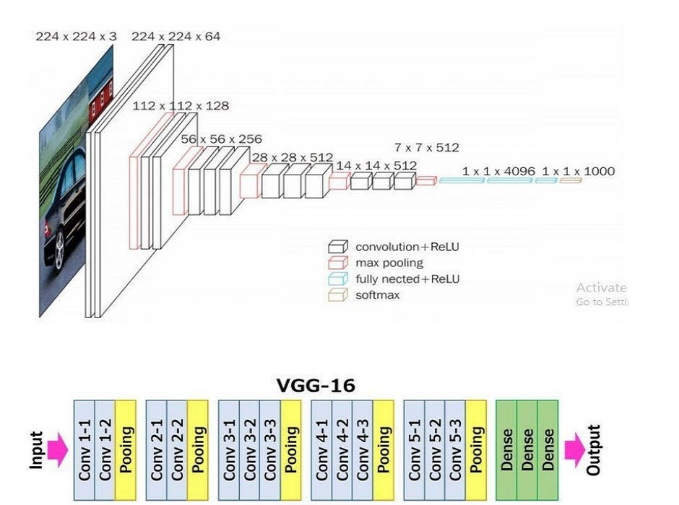
Feature Extraction
VGG16
Input resolution: 256x256
Output embedding size: 256
Advantage:
- Availability and popularity
- Deep architecture
Disadvantage:
- Computational cost
- Not designed for real-time applications
- Memory requirements
21
Notes:
The VGG16 model, known for its simplicity and effectiveness in computer vision, employs a 3×3 receptive field with a 1-pixel stride, enhancing decision functions and promoting faster convergence compared to larger layers. The use of small convolutional filters like 3×3 minimizes overfitting. Despite its advantages, VGG16 has drawbacks, including high computational cost, slow processing, and high memory consumption. With an input size of 256x256, the model produces a single embedding vector of 256 dimensions.

Slide 22
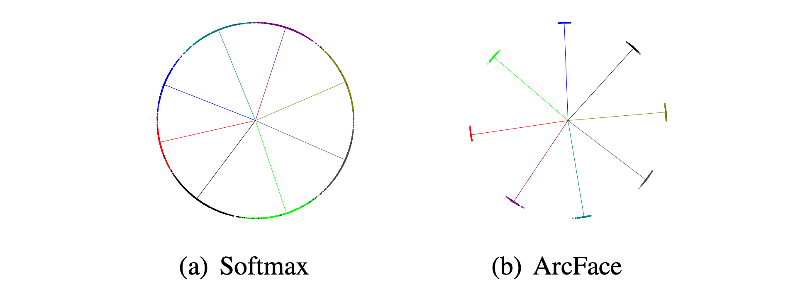
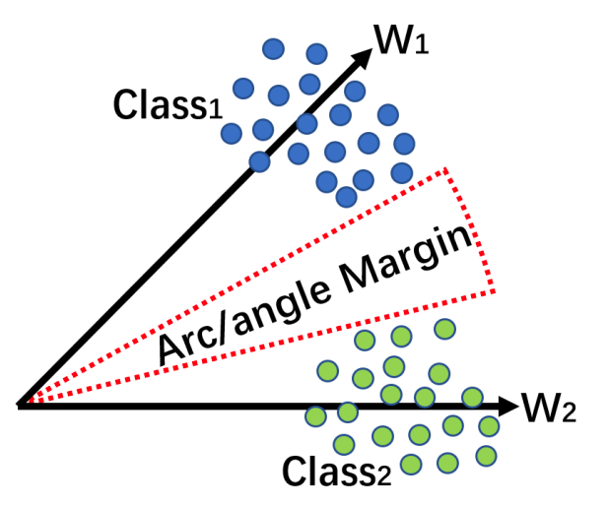
Feature Extraction
Mobilenetv3 +Arcface head
Additive Angular Margin Loss
First introduced in ArcFace: Additive Angular Margin Loss for Deep Face Recognition (2018).
Additive Angular Margin Loss (ArcFace Loss) adds a margin to the angle between the feature vector and the weight vector of each class
ArcFace loss enforce more evident gap between nearest classes.
22
Notes:
The Additive Angular Margin Loss, proposed in the 2018 paper "ArcFace: Additive Angular Margin Loss for Deep Face Recognition,"
enhances the discriminative power of deep face recognition models. This is achieved by introducing a margin to the angle between the feature vector and the weight vector of each class.
The visual representation in Figure 2 of the paper illustrates the effect of the margin (depicted as a red arc) on increasing inter-class separation and intra-class compactness.
The authors demonstrated its effectiveness by comparing it with ordinary softmax loss, visualizing the 2D feature embeddings of 8 identities.
ArcFace was shown to compact embeddings of the same identity while widening the gaps between different identities.

Slide 23
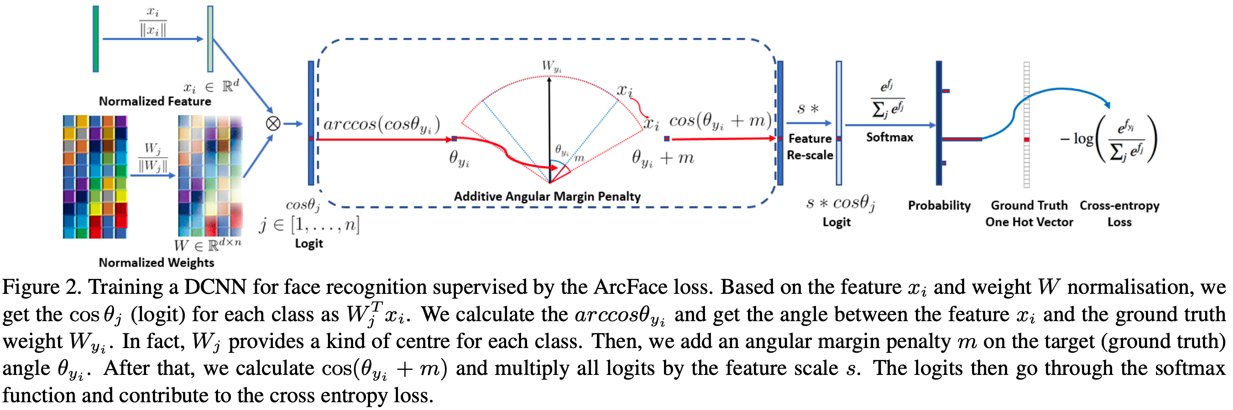
Feature Extraction
Mobilenetv3 +Arcface head
Training Procedure
23
Notes:
Here is the training procedure used in the paper which we followed.

Slide 24
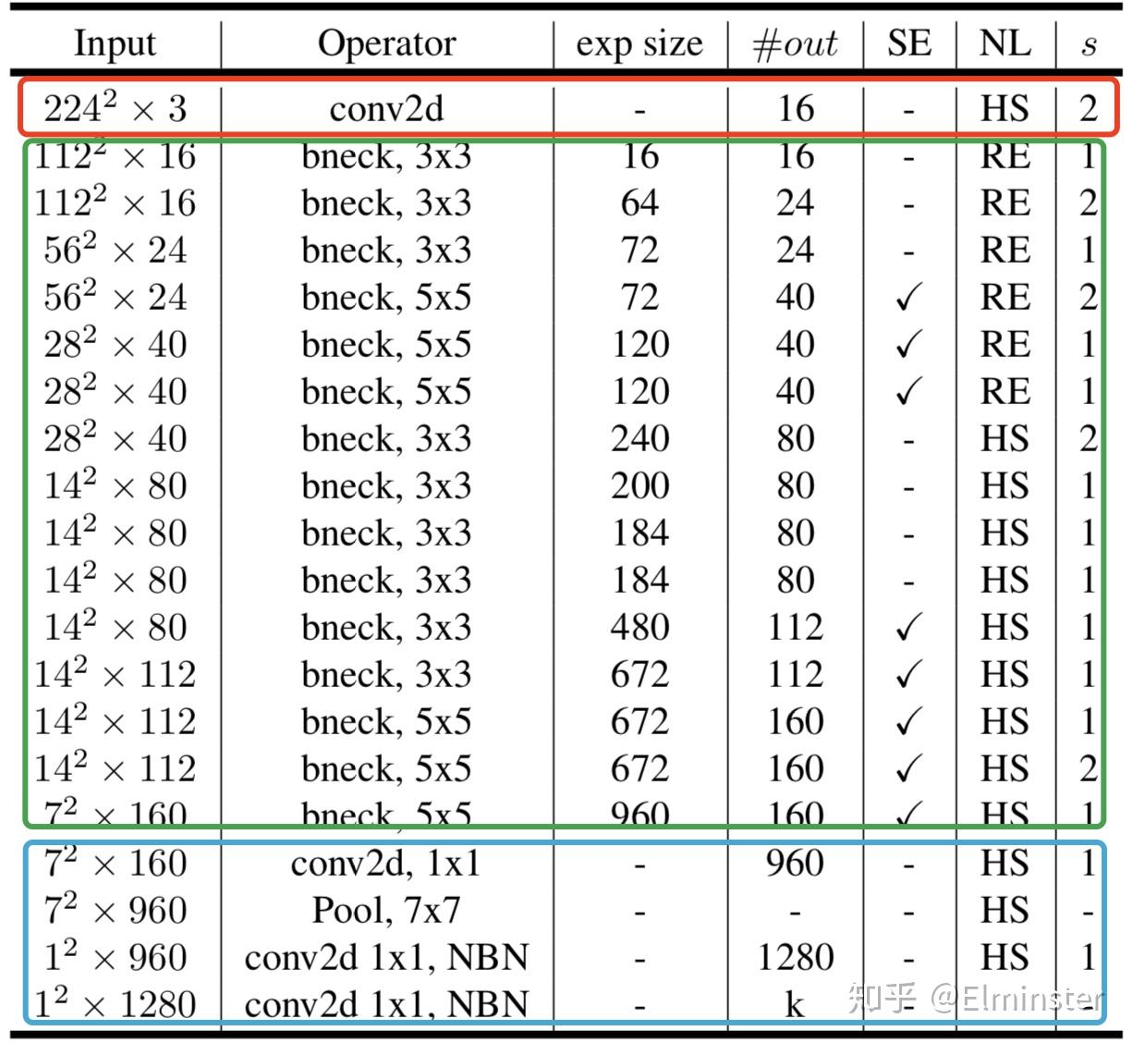
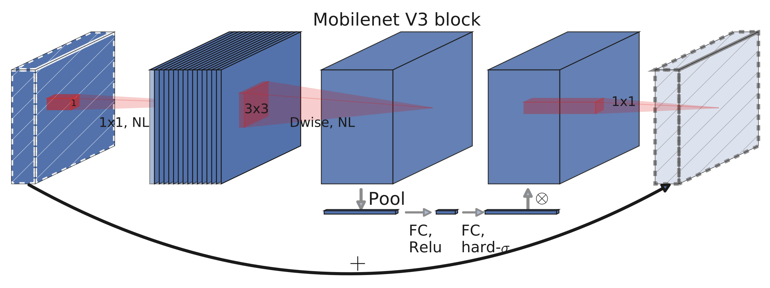
Feature Extraction
Mobilenetv3 + embedding head
MobileNetV3
Architecture
24
Notes:
The model architecture utilizes a pre-trained MobileNetV3 - small from PyTorch as the backbone, replacing its classifier with a customized embedding head. MobileNetV3 is optimized for mobile phone CPUs, employing hardware-aware network architecture search and the hard swish activation function for efficiency and accuracy. Its compact design ensures faster training and inference speeds.

Slide 25
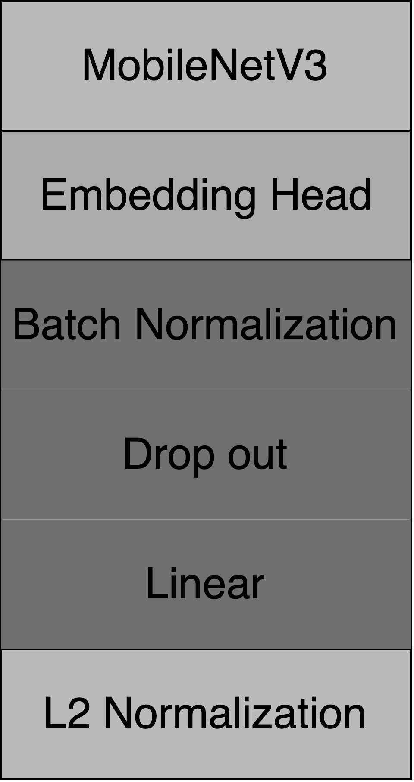
Feature Extraction
Mobilenetv3 + embedding head
MobileNetV3
Input resolusion: 224x224
Output vector size: 128
Achitechture
25
Notes:
The model takes an input image of size 224 by 224.
The embedding head consists of a batch normalization layer, a dropout layer, and a linear layer, responsible for mapping the feature map to a 128-dimensional embedding vector.
Following this, the embedding vector undergoes normalization for further processing.

Slide 26
Result
26

Slide 27
Result
Face detection
Model | Precision | Recall | mAP
YOLOv5 | 0.89 | 0.89 | 0.864
MTCNN | 0.88 | 0.99 | 0.79
SSD300(VGG16) | 0.63 | 0.657 | 0.55
Face alignment
Model | NME
ADnet | 0.19
MTCNN | 0.16
27
Notes:
The project conducts a comprehensive evaluation of face detection (YOLOv5, MTCNN, SSD300) and verification models (InceptionNetV2, VGG16, MobileNetV3)
using CELEBA and Labeled Face in the Wild datasets. YOLOv5 and MTCNN detect well, with YOLOv5 consistently performing well.
ADnet outperforms in face alignment.

Slide 28
Result
Face recognition
Model | Embedding vector | Accuracy | TPR @ FAR=10% | TPR @ FAR=1% | TPR @ FAR=0.1%
InceptionNetV2 + Triplet | 128 | 86.87 | 81.13 | 78.12 | 70.5
VGG16 + Triplet + Mining | 256 | 77.35 | 60.00 | 59.03 | 59.03
MobileNetV3 + ArcFace | 128 | 95.93 | 95.76 | 92.86 | 86.43
Model | Epochs | Time
InceptionNetV2 + Triplet | 200 | 192h
VGG16 + Triplet + Mining | 80 | 24h
MobileNetV3 + ArcFace | 80 | 80h
28
Notes:
As can be seen, all models have exceptional results:
All models achieve at least 77% accuracy with a minimum of 59% true positive rate given a false positive rate of just 0.1\%.
Overall, ArcFace Loss with MobileNetV3 gives the best result with 95.93\% accuracy and 86.43\%
true positive rate given a false positive rate of 0.1\%. Without going with the smallest model, the result could be slightly better.

Slide 29
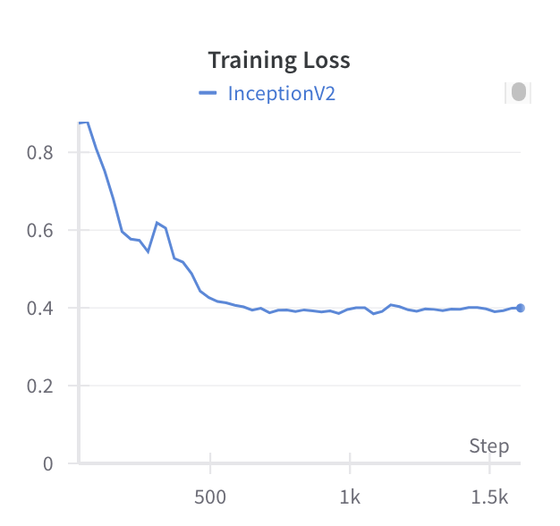
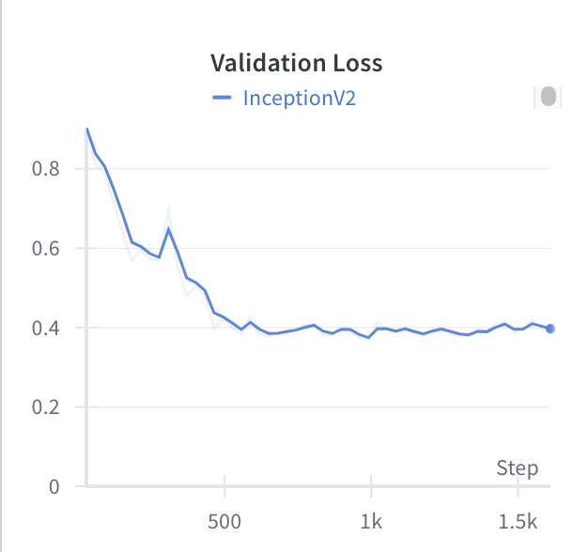
The loss curves for both the training and validation datasets are consistently smooth trajectories throughout the process
The training process is not encountering significant fluctuations or divergence
29

Slide 30
Conclusion
30

Slide 31
Conclusion
For face detection, YOLOv5 demonstrated strong precision and recall, ensuring a balanced approach to accurate predictions and capturing actual faces. MTCNN, while slightly lower in precision, excelled with remarkably high recall, capturing almost all actual faces. However, its mAP hinted at potential variability in performance. SSD300 (VGG16) exhibited limitations in both precision and recall, indicating challenges in consistent and accurate face detection.
The evaluation of face alignment using NME highlighted the effectiveness of MTCNN in predicting the positions of facial landmarks, outperforming ADNet with a lower NME, suggesting more accurate and precise facial landmark alignment.
In the realm of face verification, all models showcased exceptional results with at least 77.35% accuracy and a minimum of 59.03% true positive rate at a false positive rate of 0.1%. The ArcFace Loss with MobileNetV3 configuration yielded the best result with 95.93% accuracy and an 86.43% true positive rate. The choice of model architecture, exemplified by the improved InceptionNetV2 backbone, significantly contributed to the overall success.
In conclusion, the comprehensive evaluation emphasized the strengths of YOLOv5 and MTCNN in face detection, MTCNN in face alignment, and MobileNetV3 with ArcFace Loss in face verification. The findings contribute valuable insights for optimizing face recognition systems in diverse applications.
31

Slide 32

Future Scope
1
Improved accuracy
2
Real-time recognition
3
Privacy concerns
With the advancement of machine learning algorithms and deep learning neural networks, the accuracy of facial recognition technology is expected to significantly improve in the coming years.
Facial recognition technology poses risks to privacy, and ethical frameworks will need to be developed to regulate its use in an increasingly digitalized world.
Real-time facial recognition will become more efficient and prevalent, with applications in security and surveillance as well as healthcare.
32

Slide 33
THANK YOU
for listening
33

Slide 34
Task management
Doan Ngoc Cuong 20210141​ | YOLOv5, Adnet, report, slide
Nguyen Minh Cuong 20210140​ | MTCNN, report
Bui Khanh Linh 20214910​ | SSD, report, slide
Tran Le My Linh 20210535​ | Inceptionv2, report, slide
Nguyen Thanh Long 20214912 | VGG16, slide, demo, report
Nguyen Minh Tuan 20214940 | Mobilenet, face verification dataset, face verification result, report
34

Slide 35
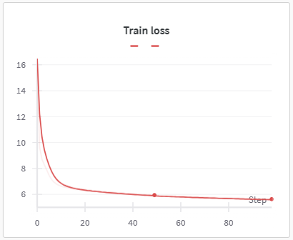
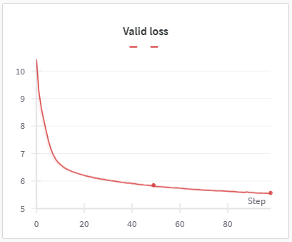
Loss for SSD

